Slide 1
Sports Management System User Manual
Active 364

Slide 2
Table of Contents
General:
Pg. 3 System overview
Installation:
Pg. 4 Eclipse Installation
Pg. 5-8 IntelliJ Installation
Screen Guides:
Pg. 9-12 Home Page
Pg. 9: Home Page
Pg. 10: Guest Home Page
Pg. 11: User Home Page
Pg. 12 Login
Pg. 13 Create\Edit Account
Pg. 14 Team Page
Pg. 15 Edit Team Page
Pg. 16 Event Page
Pg. 17 Create\Edit Event
Pg. 18 Join Team
Contact:
Pg. 19 Contact Info

Slide 3
System Overview
The Sports League Management System is a program dedicated to keeping the client informed on the current scores or events for recreational Sports or eSport teams.
Active News Feed for current scores and upcoming events
Allows the client to follow teams
Client can communicate with team via wall posts

Slide 4
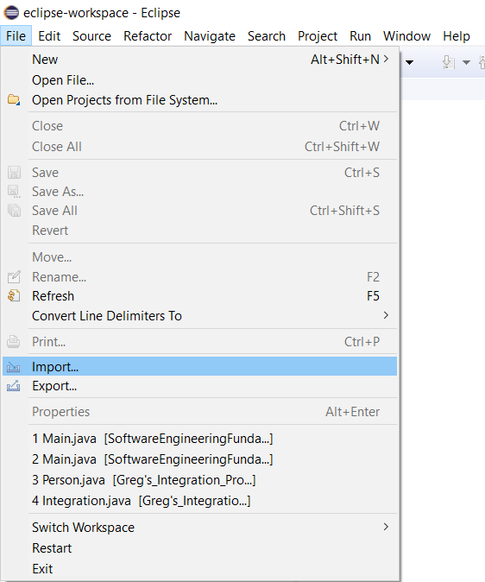
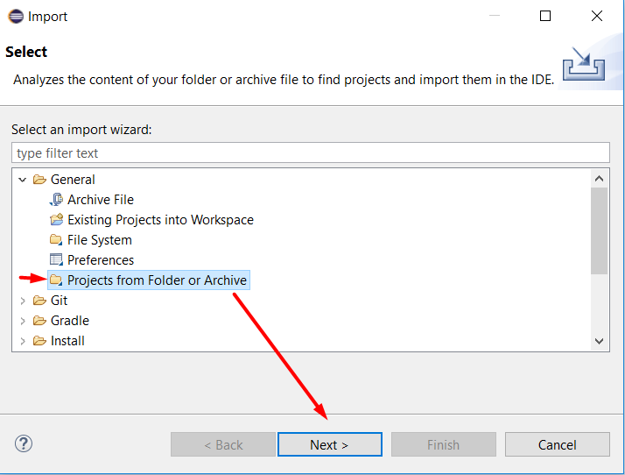
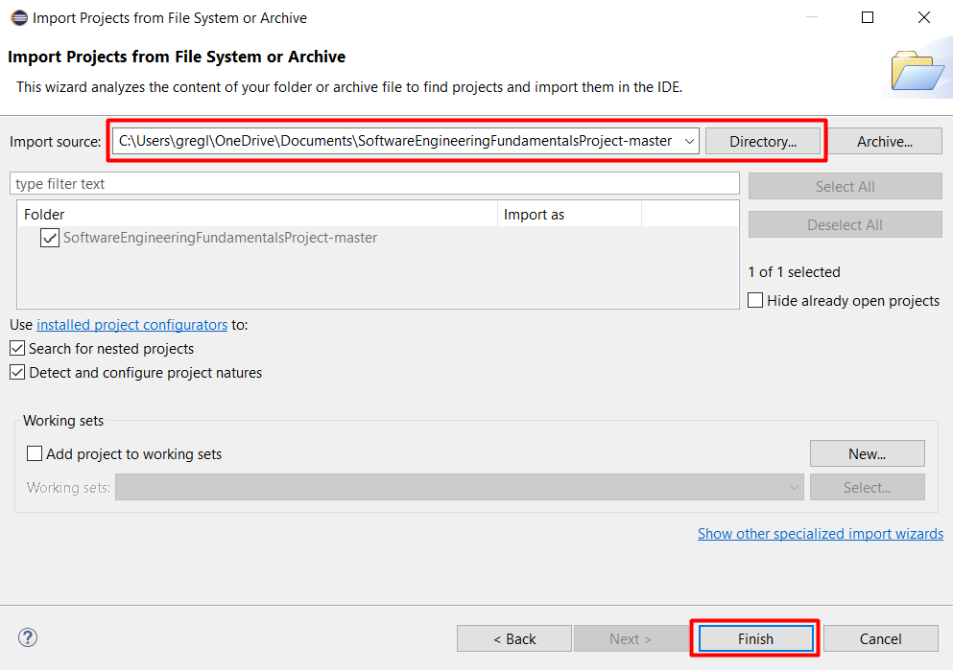
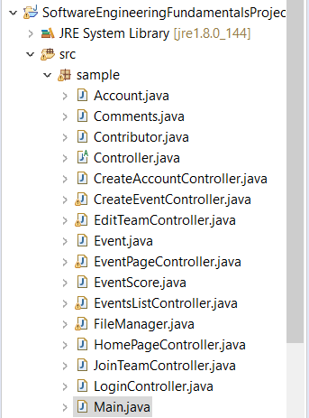
Installation: Eclipse
Download the zip of this project and extract to desired directory
Click File->Import
Select General->Projects from Folder or Archive then click Next
Click Directory, select extracted folder, and click OK
Click Finish
Navigate to Main class (src\sample\Main)
Click Run button

Slide 5
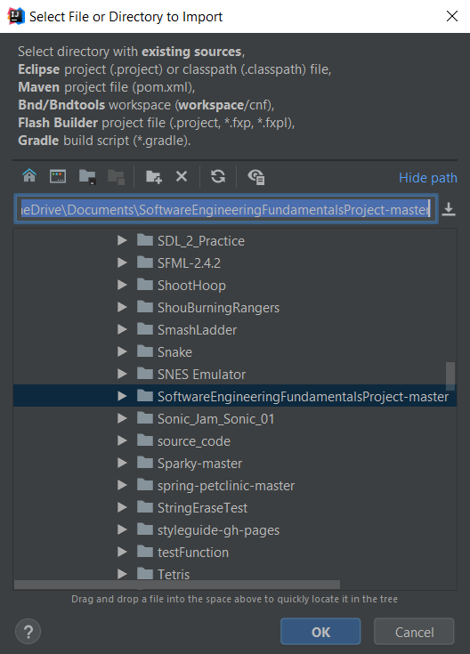
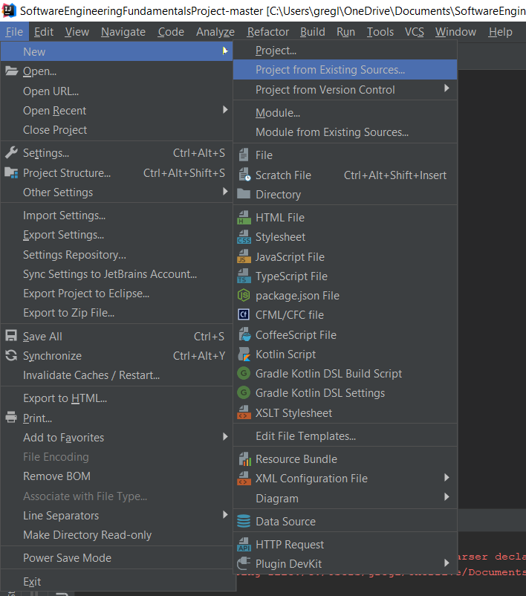
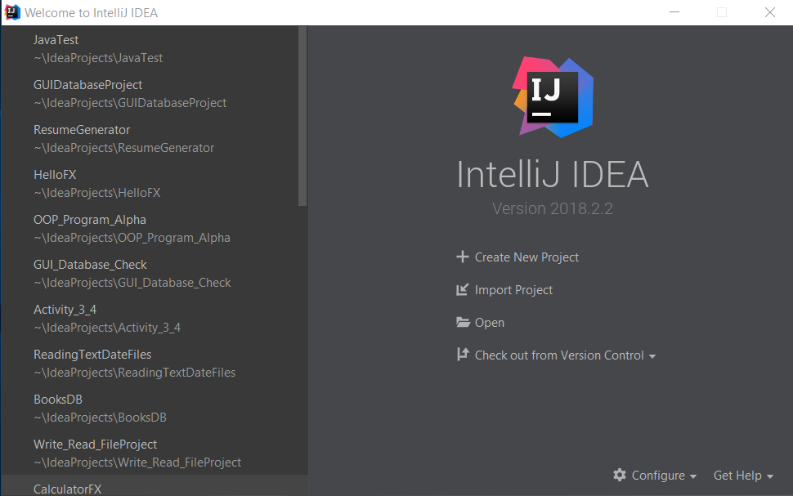
Installation: IntelliJ
Download the zip of this project and extract to desired directory
Click Import Project from splash screen or File->New->Project from Existing Source Code
Select extracted folder and click OK

Slide 6
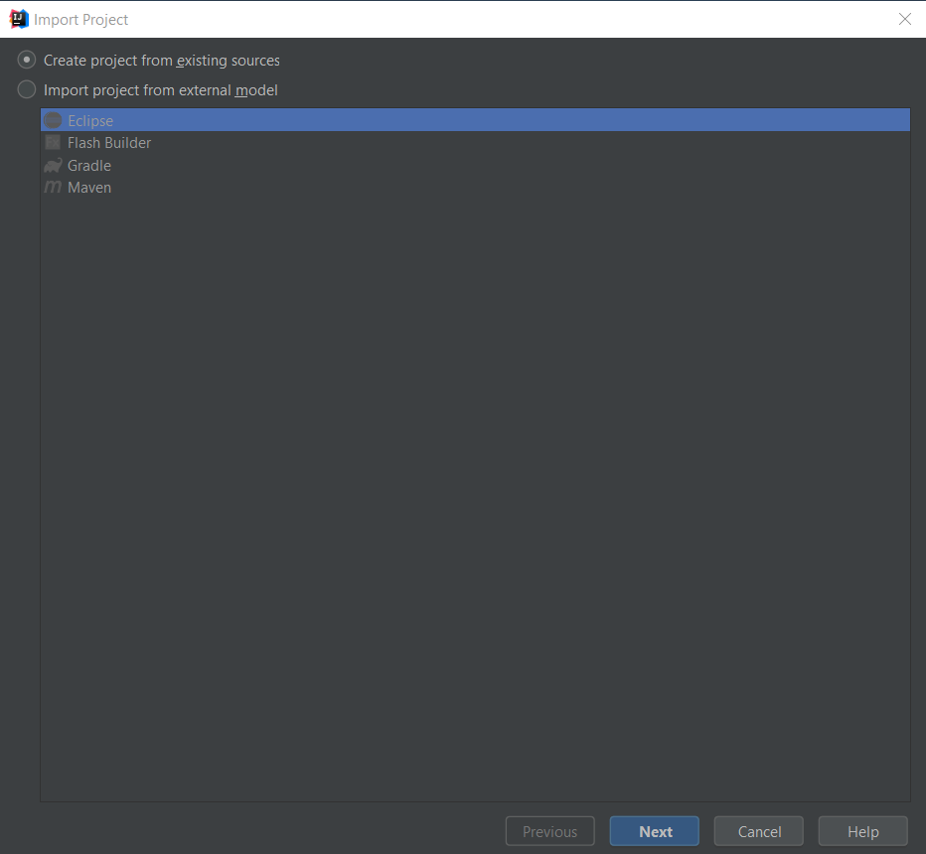
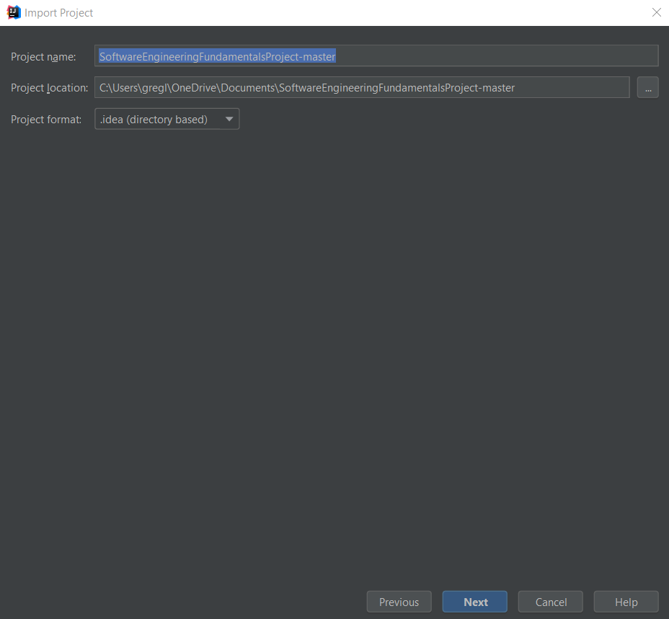
Installation: IntelliJ
Click Next->Name Project and set location->Click Next

Slide 7
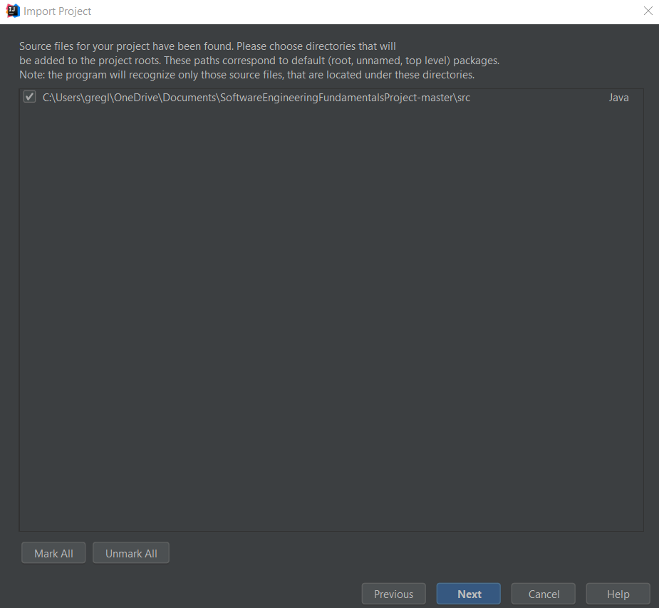
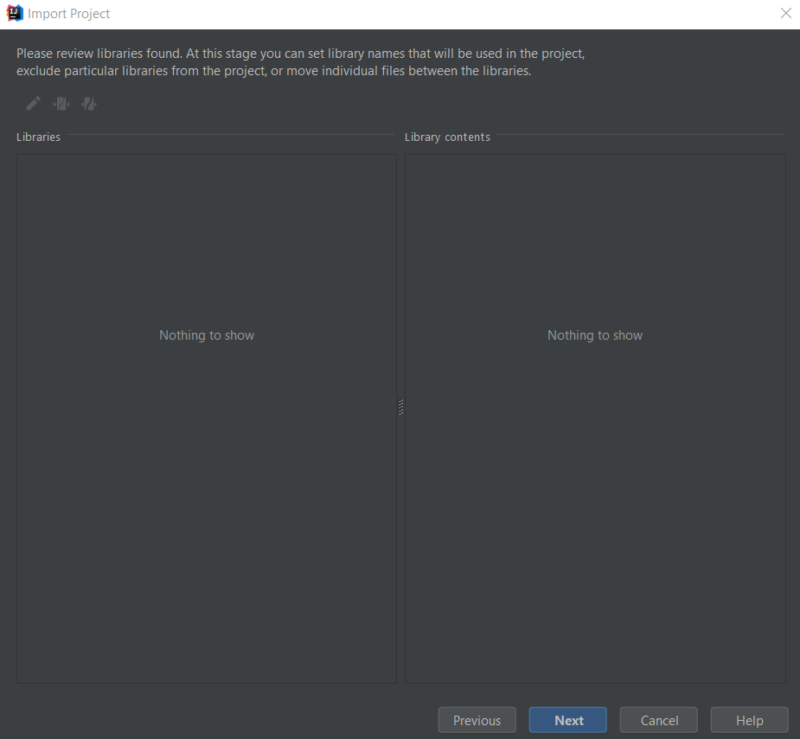
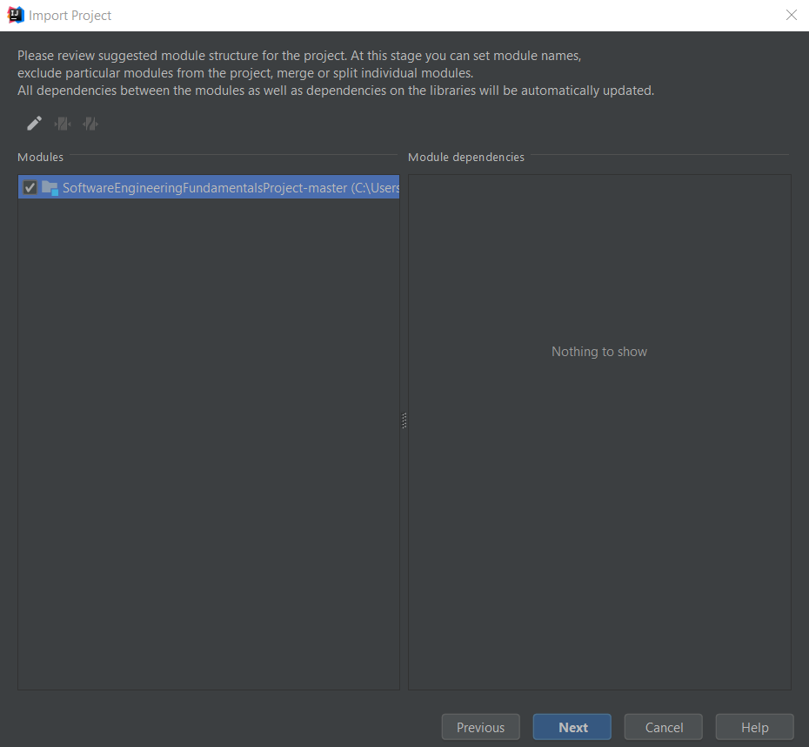
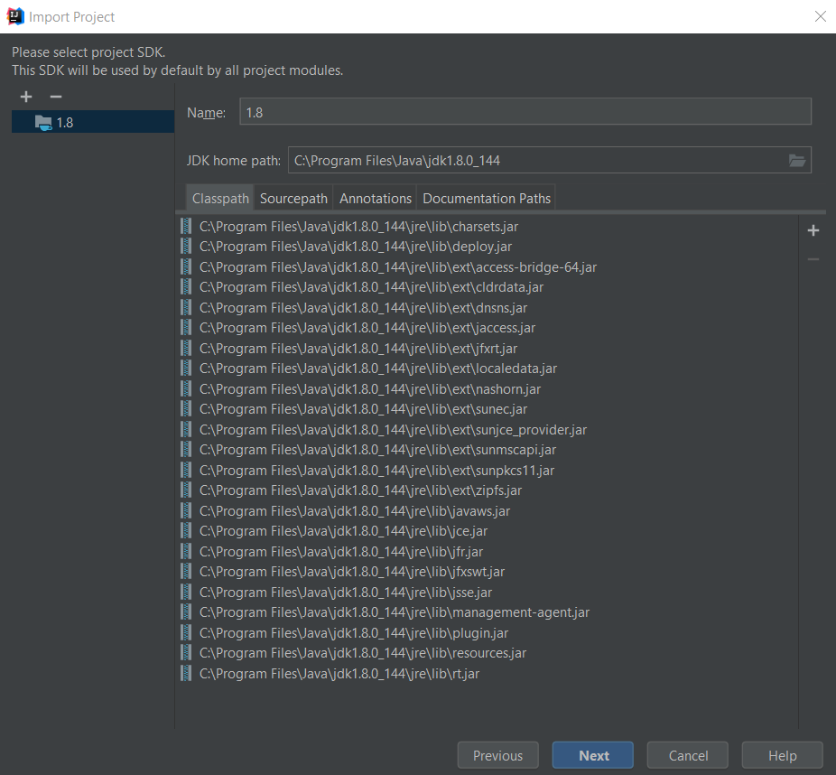
Installation: IntelliJ
Click Next until Finish button appears->Click Finish

Slide 8
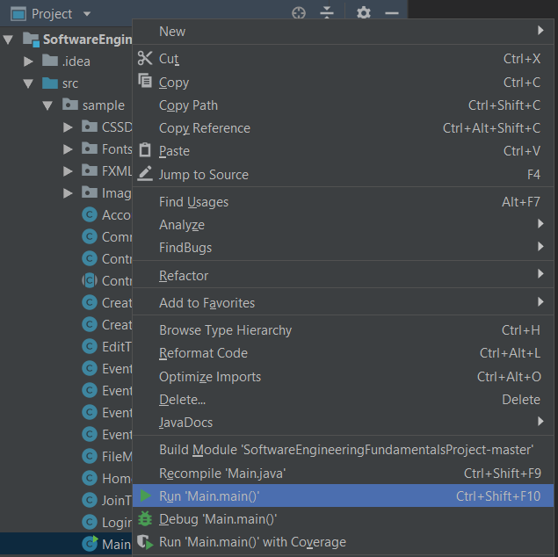
Installation: IntelliJ
Navigate to Main class (src\sample\Main)
Right click Main class and click Run 'Main.main()'

Slide 9
Home Page
There are four different layouts for the Sports Management application depending the account type of the current user.
Guest
Spectator
Player
Manager
The first thing users will see when booting up the application is the guest home page.

Slide 10
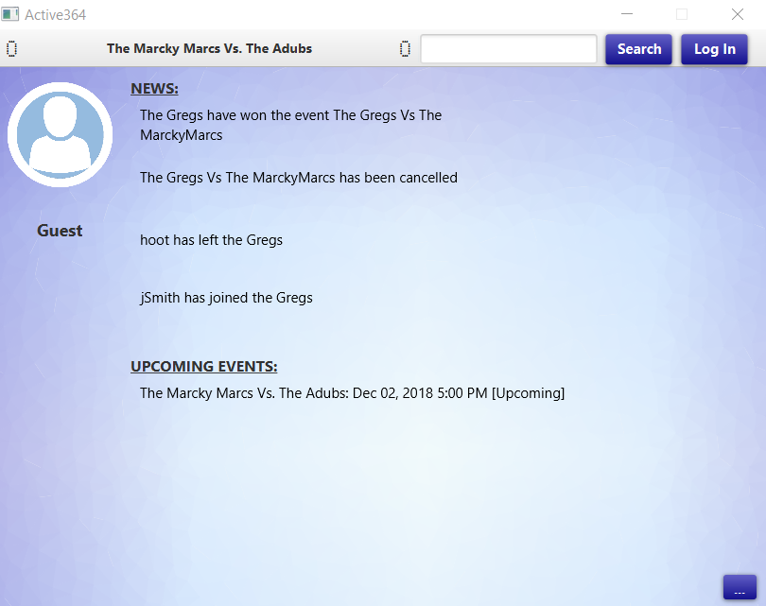
Home Page: Guest
4
3
2
1
The page will be displayed for guests who have not created an account.
Login Button: When clicked, will send the current user to login screen
Search Button: When clicked, will send the current user to the page of the team entered in the team search bar.
Team Search Bar: Used to search teams by entering in a team’s name.
Closest Upcoming Event: The event occurring closest to the current date. Displays event name as well as the scores.
News: Displays the latest news with teams and events (e. g. New teams created, players joining/leaving team, and event winners). The guest page will display all news headlines that have been made, while a user’s homepage will display news corresponding with their follow list and team if applicable.
Upcoming Events: Displays events that occur after the current date. The guest page will display all events that are upcoming, while a user’s homepage will display upcoming events corresponding with their follow list and team if applicable.
Expand Events List: Will display a list of events regardless of whether they occur before or after the current date. The guest page will display all events, while a user’s homepage will display events corresponding with their follow list and team if applicable.
5
6
7

Slide 11
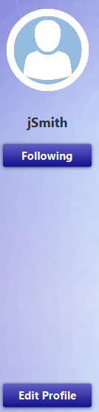

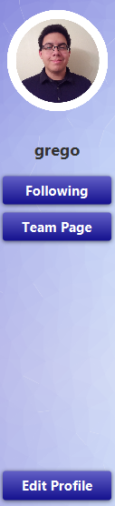
Home Page: Users
Spectator:
Profile Picture/Username: Displays the current user’s profile picture and username. If a profile picture was not set, then a default picture will be displayed.
Following Button: Will display a list of the current user’s follow list
Edit Profile Button: When clicked, will send the current user to the edit account screen.
Player/Manager:
Join Team/Team Page Button: When clicked, depending if the current user is already part of a team, the current user will be sent to their team’s page, if they are not already part of a team they will be sent to the request to join screen.
1
2
1
3

Slide 12
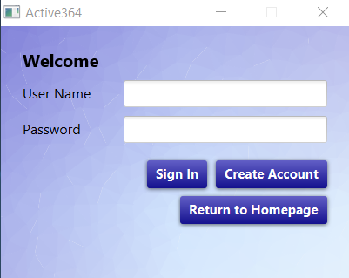
Login
The user is able to log onto their account once they have been registered. If the user has not been registered, they can create their account or return to the homepage.
Username: User enters their username in this text field to sign in.
Password: User enters their password in this text field to sign in.
Sign In Button: When clicked, if the username and password entered are valid, this will send the current user to their home page, otherwise the user will be notified what they have entered is not valid.
Return to Homepage Button: When clicked, will send user back to the previous home page.
Create Account Button: When clicked, will send the current user to the create account screen.
1
2
3
5
4

Slide 13
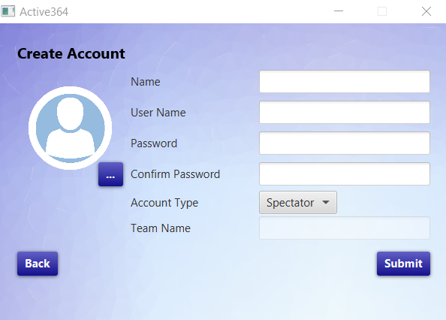
Create\Edit Account
1
Name: User’s name, which can consist of any letters, symbols, or numbers.
Username: User’s username, which can consist of any letters, symbols, or numbers as long as username is not already taken.
Password: User’s password, which can consist of any letters, symbols, or numbers.
Confirm Password: User must reenter password to successfully create or change password.
Account Type: Type of account user wants to make or change into. User has the option of spectator, player, or manager each with their own specific permissions.
Team Name: Must be filled if user is creating or changing their account to a manager account. Can consists of any letters, symbols, or numbers as long as team name is not already taken.
Profile Picture Button: When clicked, user can navigate through their files and select an image they’d like to have as their profile picture. Only PNG files can be used as profile pictures.
Submit Button: When clicked, if all required text fields are filled in with the appropriate values, this will send the current user to their home page or notify them their edits have been successful, otherwise the user will be notified what they have entered is not valid.
Back: When clicked, if accessed from home page user will return to home page. If accessed from sign in screen user will return to login screen.
2
3
4
7
5
6
8
9

Slide 14
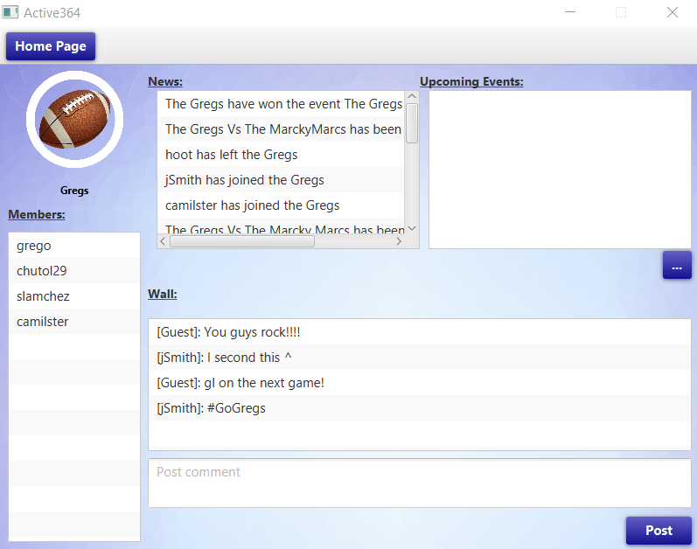
Team Page
3
2
1
Upcoming Events: Will display a list of events the current team is involved with that occur after the current date.
News List: Displays the latest news with teams and events involving the current team.
Home Page Button: When clicked, will send user back to home page.
Members List: List of members in the current team. All members lists begin with a team’s manager.
Edit: When clicked, will send the current user to the edit team screen.
Follow/Unfollow: When clicked, depending if whether or not the current user is follow the current team, will affect the current user’s follow list. This option will not be available for users that are member of the current team.
Post Button: When clicked, if the comment box is filled in, will add the current user’s comment to the current team’s wall.
Comment Box: Users can enter comments here.
Wall: List of comments left by users related to the current team.
Expand Events List: Will display a list of events the current team is involved with regardless of whether they occur before or after the current date.
4
10
9
8
7
6
5

Slide 15
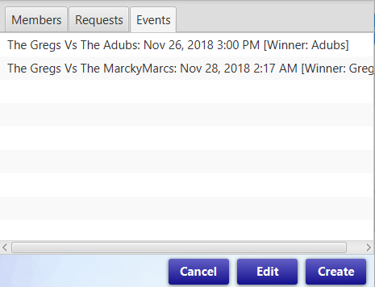
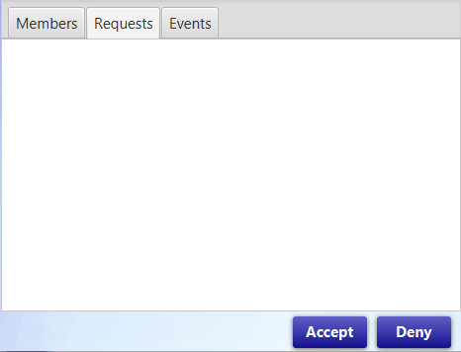
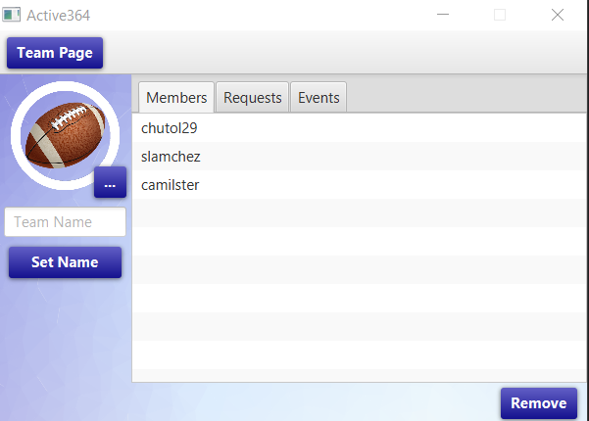
Edit Team Page
6
Coaches are able to accept or decline incoming player requests, kick current team players, create and edit preexisting events, or manage the team.
Team Page Button: When clicked, will return user to team page.
Profile Picture Button: When clicked, the user can navigate through their files and select an image they’d like to have as their team profile picture. Only PNG files can be used as profile pictures.
Team Name: Managers can change their team’s name through here.
Set Name Button: When clicked, if the user entered a valid name, the current team’s name will be changed to what the user entered.
Members List: Will display a list of team members, selecting a player in this list will make said player the selected player.
Requests List: Will display a list of join requests sent by players, selecting a player in this list will make said player the selected player.
Events List: Will display a list of events that the current team’s manager has organized, selecting an event in this list will make said event the selected event.
Remove: When clicked, will remove the selected player from team.
Accept: When clicked, will add the selected player to team.
Deny: When clicked, will remove the selected player from team requests list.
Cancel: When clicked, will delete the selected event.
Edit: When clicked, will send the current user to the edit event screen.
Create: When clicked, will send the current user to the create event screen.
7
11
12
13
9
10
1
5
2
3
4
8

Slide 16
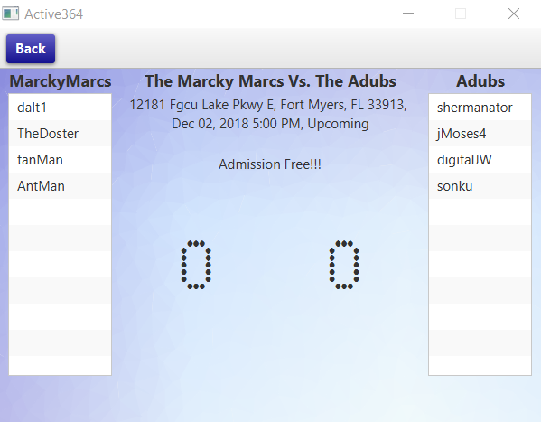
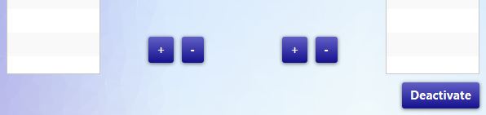
Event Page
3
2
1
The event page displays the roster for each team competing, a description of the event, and the current score. Coaches are able to add or subtract points from the scoreboard.
Event Name: Displays current event’s name
Event Info: Displays current event’s location, start date, status, upcoming, ongoing, or ended, and description.
Back Button: When clicked, depending on where page was accessed, will return user to previous page.
Teams: Displays team names and members.
Scores: Displays event scores of teams involved.
Manager Event Page:
Increment/Decrement Buttons: When clicked, will increment or decrement respective team’s score.
Deactivate Button: When clicked, event will no longer be editable and will have a winner depending on final scores.
4
5
1
2

Slide 17
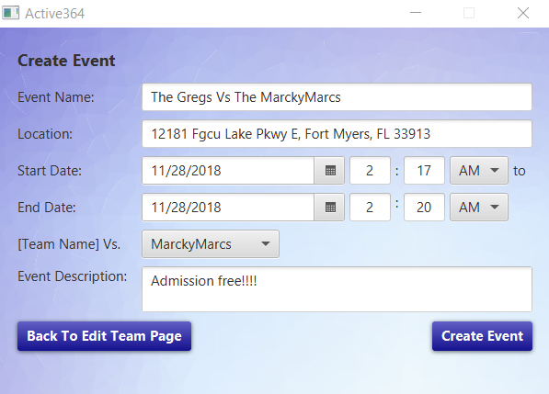
Create\Edit Event
2
1
Coaches are able to create or edit preexisting events and post them so people who are currently following the team will be notified about future events.
This will be empty if the current user is creating an event, otherwise all fields will be filled with the info of the event that’s being edited.
Event Name: Event’s name, which can consist of any letters, symbols, or numbers as long as username is not already taken.
Location: Event’s location, which can consist of any letters, symbols, or numbers, but preferably the address of the Event’s location.
Start Date: Start date of event using the date from date picker, hour, minute, and whether time is AM or PM. Hour and minute must be whole numbers between 1 to 12 or 0 to 59 respectively.
End Date: End date of event using the date from date picker, hour, minute, and whether time is AM or PM. Hour and minute must be whole numbers between 1 to 12 or 0 to 59 respectively.
Vs. Combo Box: Current user can select which team will be involved in the event being edited or created.
Event Description: Description of event, which can consist of anything such as price of admission.
Back to Edit Team Page: When clicked, will send the current user to the edit team page.
Create Event Button: When clicked, if all required text fields are filled in with the appropriate values, this will send the current user to the edit team page or notify them their edits have been successful, otherwise the user will be notified what they have entered is not valid.
3
4
5
6
7
8

Slide 18
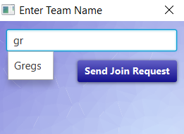
Join Team
1
Players are able to send a request to join a team and will be approved or denied by the coach of that team.
Team Name: Text field where the current user can enter in the name of the team they want to join.
Context Menu: Drop down menu that appears as the current user types. Will contain the teams, who’s names are a close match to what the user has typed. When an item is clicked, the team name text field will be auto filled with the team name that was clicked.
Send Join Request: When clicked, if the user has entered in a valid team name, the stage will close and notify the user their request is pending, otherwise the user will be notified that what they have entered is not valid.
2
3

Slide 19
Contact
Currently there is no HELP Desk set up for this program, but you can email the developers for any known issues with he program at:
abwilson5729@eagle.fgcu.edu
gjlozada8704@eagle.fgcu.edu
grpereira1714@eagle.fgcu.edu
jmsherman9253@eagle.fgcu.edu
jmmoses2190@eagle.fgcu.edu
jsasek5815@eagle.fgcu.edu

